Slide 1
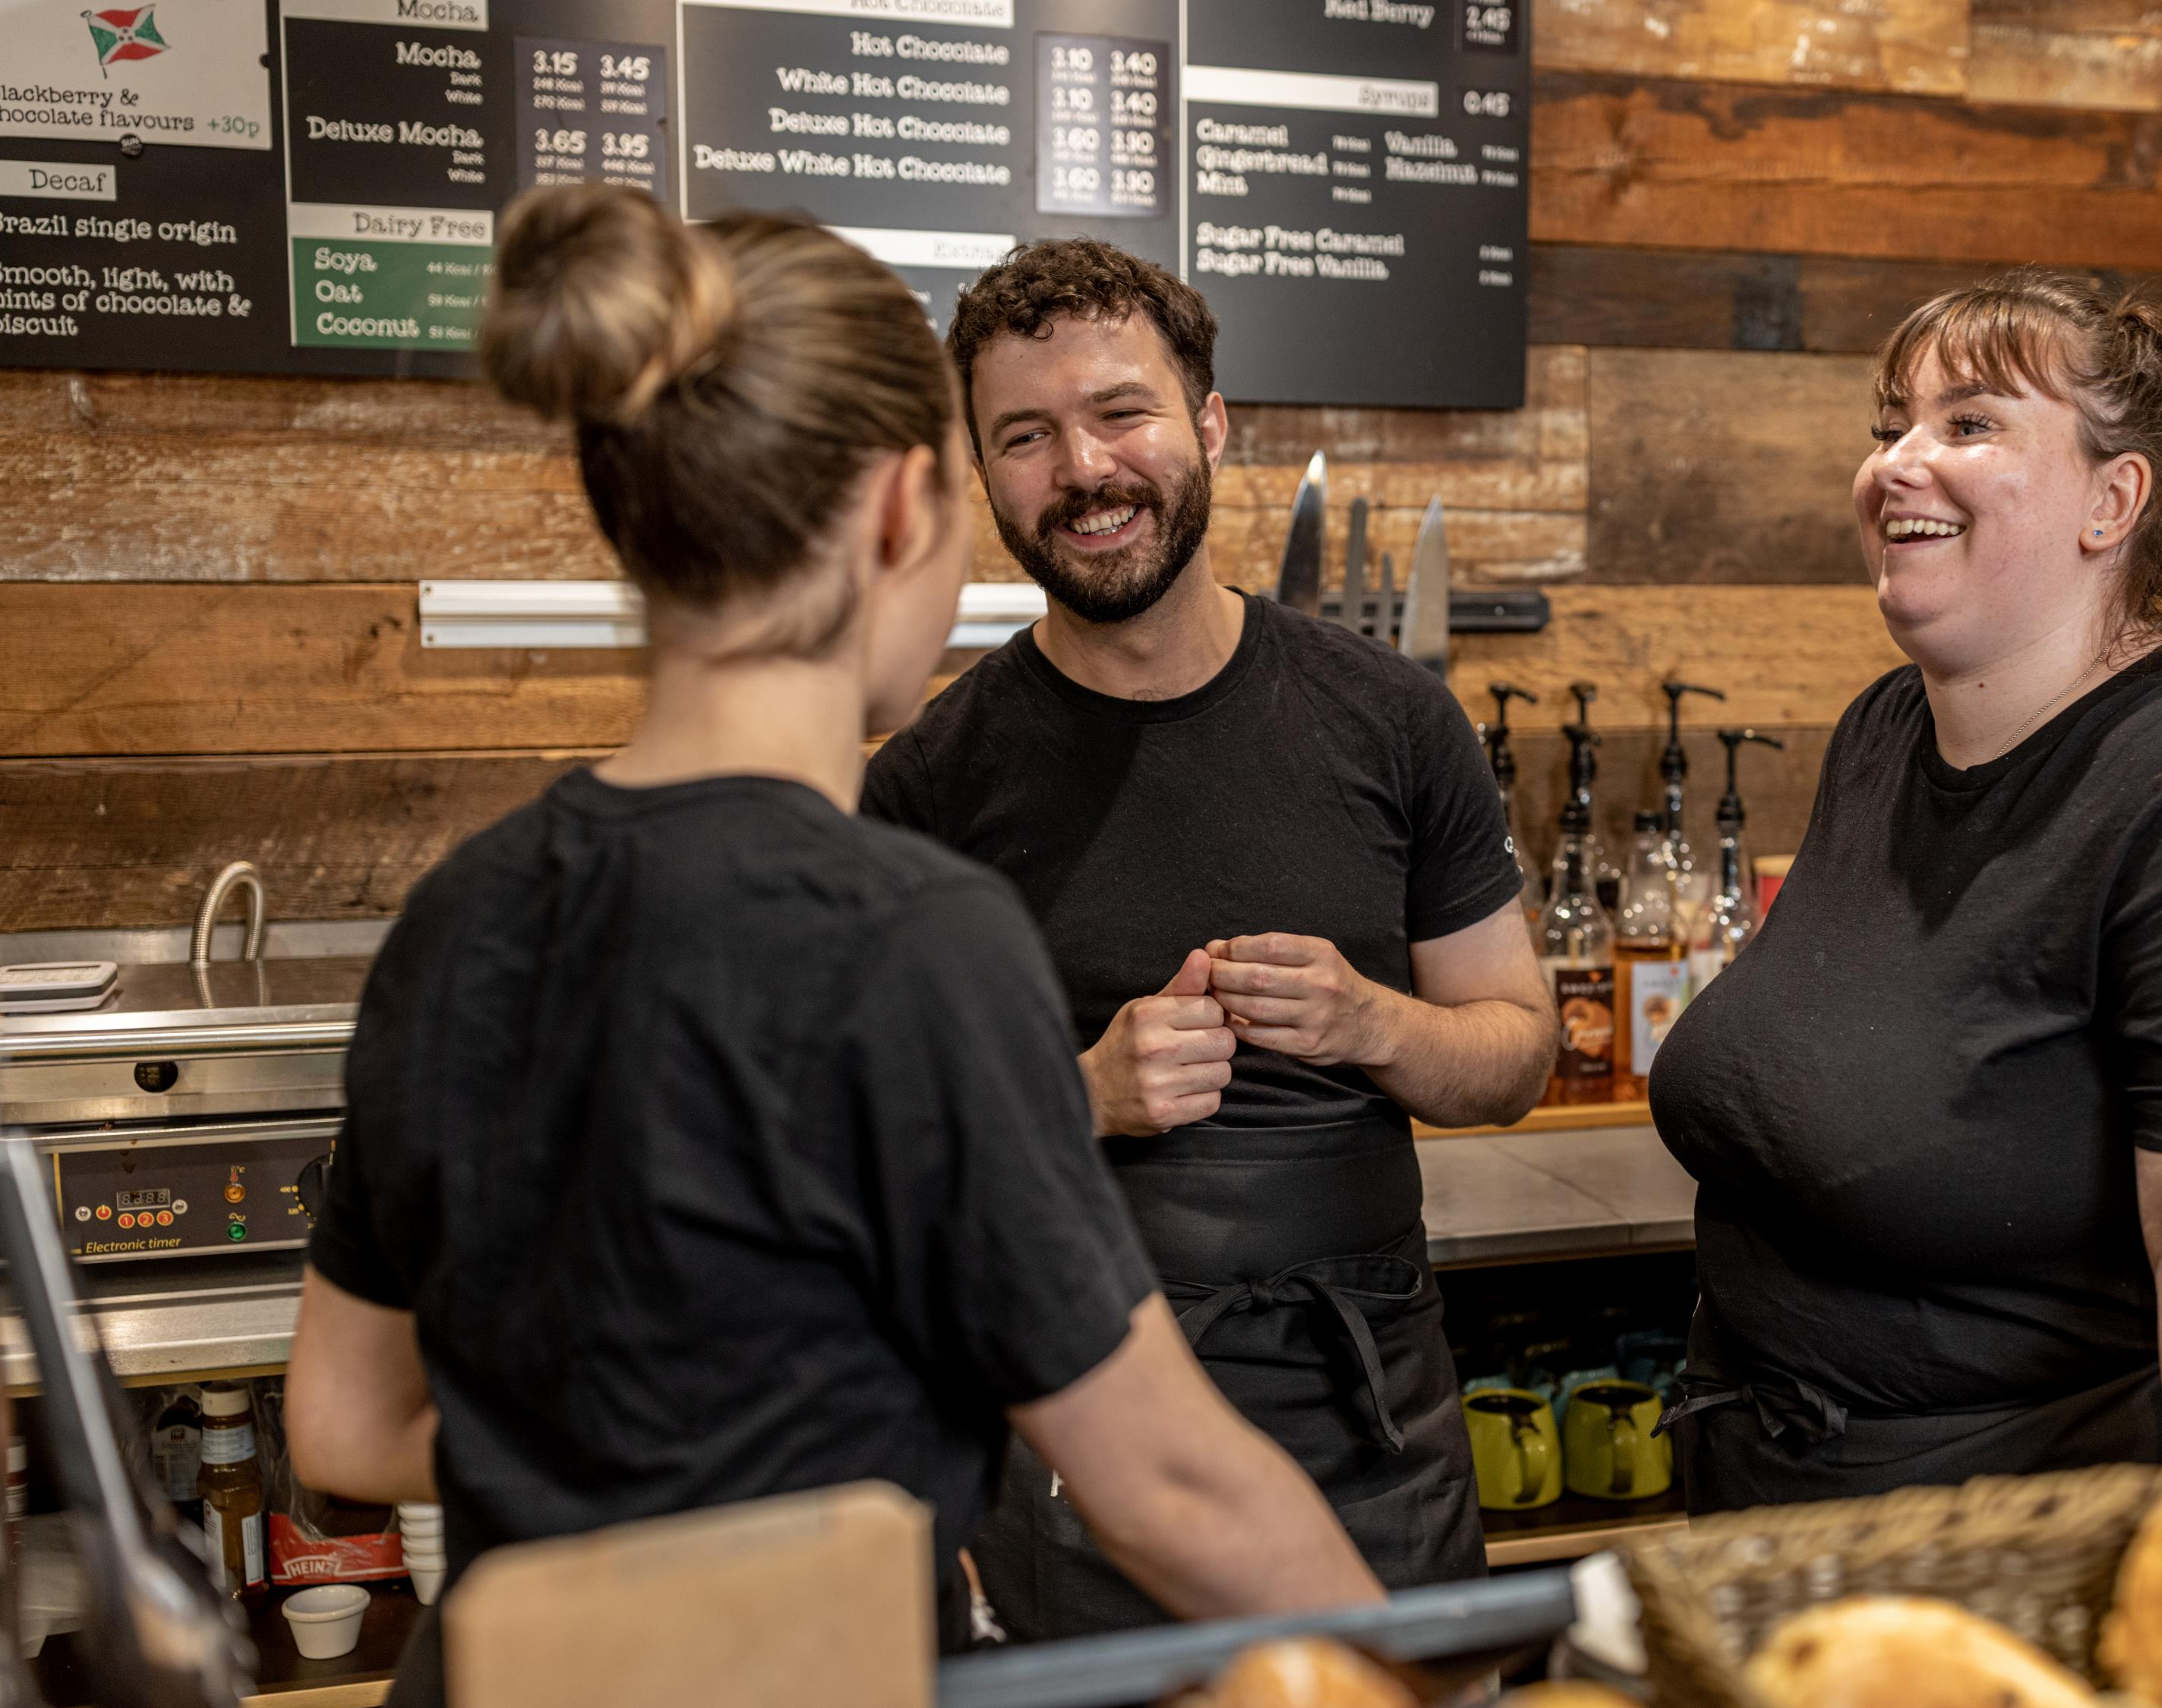

GENDER PAY REPORT 2024

Slide 2

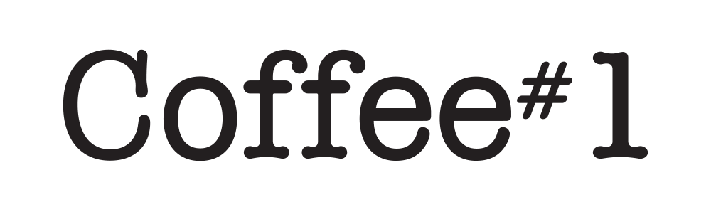
GENDER PAY GAP 2020
Coffee#1 is proud to be an inclusive business that is welcoming of the different nationalities, sexualities, cultures and genders and the valued and varied perspectives everyone provides.
We are required to report on gender pay rates annually based on a snapshot of data taken from 5th April 2023 using all qualifying employees.
Our mean and median gender pay gaps have closed significantly and there is now non statistical variation between male and female pay. The mean pay gap sits at -0.2% and median pay gap at 1.2%, where these measures sat at >20% in 2020.
Bonus pay gaps remain, where senior management bonus payment has a significant effect on results.
We remain committed to reducing the gender pay gap within the company and will continue to monitor, review and make changes to improve.
I am confident that the data and information reported are accurate as of the snapshot date of 5 April 2023 and have been calculated according to the requirements of The Equality Act 2010 (Gender Pay Information) Regulations 2017.
Bruce Newman
Manging Director, Coffee#1
Gender Pay Report Statement
At Coffee#1, we are committed to fostering an inclusive and equitable workplace where all employees are valued and rewarded fairly. Our latest gender pay analysis reflects our ongoing commitment to closing the gender pay gap and promoting equal opportunities across all levels of our organization.
Visible Female Leadership
We are proud to have strong female representation in leadership roles, demonstrating our commitment to diversity at the highest levels. 60% of our senior leadership team are held by females, while over 60% of our Support Centre roles and 50% of our operations team employees are women. As an employer that values progression and succession, we have a clear pathway that is open to employees regardless of gender, race, sexuality or culture and are proud of the diversity of our employee base.
Family-Friendly Working Arrangements
We recognize the importance of work-life balance and offer flexible, family-friendly working arrangements, that includes hybrid working, parental leave, and return-to-work support programs. These initiatives are designed to support employees fulfil their family responsibilities, without making career compromises.
Employee Engagement
We are proud to see that employee engagement at Coffee#1 is at its highest level, with 79% of employees recommending our company as a place of work. This reflects our ongoing efforts to create an inclusive, highly supportive, and empowering workplace culture where our teams are encouraged to seek the support and help that can make their careers more fulfilling and rewarding. We continue to listen to employee feedback, invest in initiatives that enhance career development, well-being, and job satisfaction and make the improvements to the methods through which we illicit employee feedback.
Commitment to Progress
While we have made significant strides, we remain dedicated to further reducing the gender pay gap through targeted actions, including leadership development programs, equitable promotion pathways, and continuous review of our policies to ensure fairness and transparency.
At Coffee#1, we believe that a diverse and inclusive workplace is essential for employee engagement, enjoyment and fulfilment. We will continue to take proactive steps to drive meaningful change and create a truly equitable working environment for all.
Bruce Newman
Coffee#1 Managing Director
March 2025
Bruce Newman
Managing Director, Coffee#1

Slide 3

Our Results
 | 2020 (%) | 2021 (%) | 2022 (%) | 2023 (%) | 2024 (%)
Gender pay gap as a mean average (%) | 23.3 | 14.2 | 9.3 | -0.2 | 4.70
Gender pay gap as a median average (%) | 22.5 | 6 | 1.2 | 1.2 | 0.34
Gender bonus pay gap as a mean average (%) | 19.1 | 27.6 | 45.1 | 75.4 | 76.15
Gender bonus pay gap as a median average (%) | 13.1 | 4.1 | 16.0 | 92.6 | 19.33
Proportion of males receiving bonus (%) | 19.6 | 16.3 | 66.9 | 51.1 | 45.26
Proportion of females receiving bonus (%) | 13.2 | 11.6 | 68.0 | 45.9 | 50.45
Coffee#1 - Gender Pay Report 2024

Slide 4


OUR RESULTS
Gender pay gap as a mean average
The difference in pay between our total wage spend-per-woman and our total wage spend-per man.
Gender pay gap as a median average
The difference in pay between the middle-ranking woman and the middle-ranking man.
4.70%
0.34%
MEAN BONUS PAY GAP
Gender bonus pay gap as a mean average
The difference in bonus between our total bonus paid-per-woman and total bonus paid-per-man
Gender bonus pay gap as a median average
The difference in bonus pay between the middle-ranking woman and the middle-ranking man.
76.15%
19.33%
Coffee#1 - Gender Pay Report 2024

Slide 5
OUR RESULTS
Proportion of Males and Females by Pay Quartile
Proportion of Males and Females receiving bonus
Coffee#1 - Gender Pay Report 2024

Slide 6
GENDER PAY GAP 2020
Our Plan
As we continue our journey toward an even more inclusive and rewarding workplace, we will focus on:
Ongoing Review of Pay & Benefits - We will regularly assess salary structures, bonuses, and benefits to maintain fairness and competitiveness.
Expanding Development Programs - New training and development initiatives will be introduced to provide employees at all levels with the skills and opportunities needed for career growth.
Transparent Pay & Progression Reports – Regularly sharing insights on pay equity and promotion trends to maintain transparency and trust.
Ensuring Merit-Based Progression - We remain committed to recruitment and reward processes that are entirely based on skills, contribution, and performance.
With over 79% of our employees recommending Coffee#1 as a great place to work, we are proud of our culture and will continue building an environment where everyone can succeed.

