Slide 1
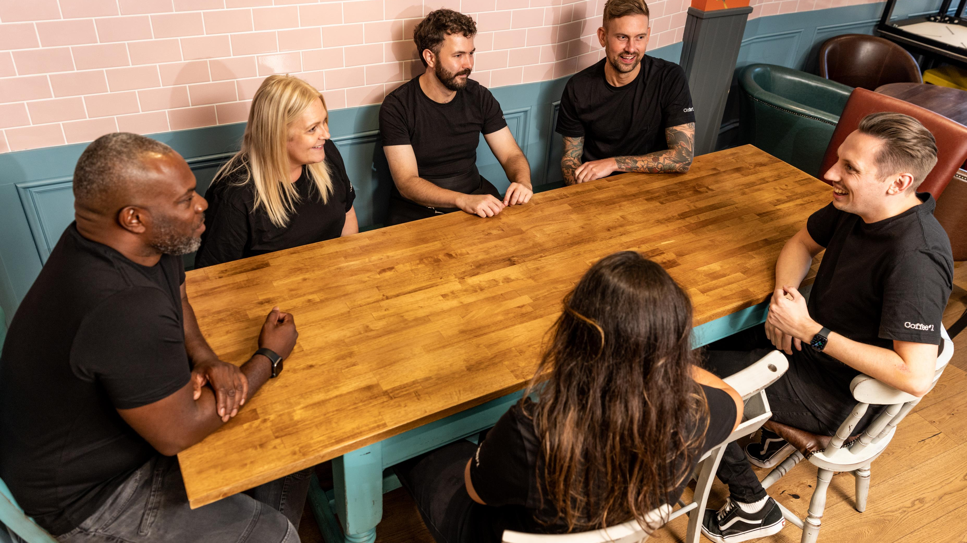
GENDER PAY REPORT 2023

Slide 2

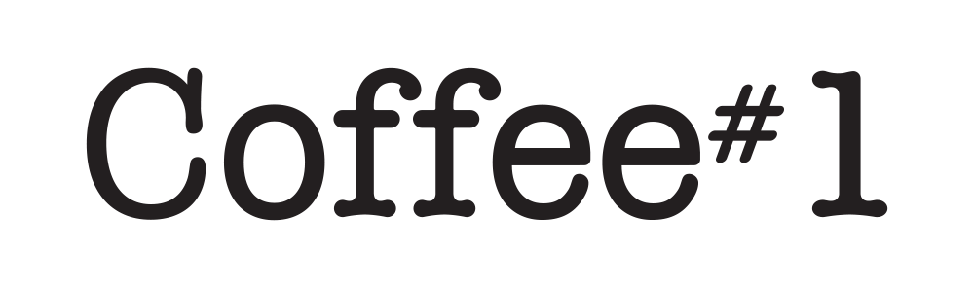
GENDER PAY GAP 2020
Coffee#1 is proud to be an inclusive business that is welcoming of the different nationalities, sexualities, cultures and genders and the valued and varied perspectives everyone provides.
We are required to report on gender pay rates annually based on a snapshot of data taken from 5th April 2023 using all qualifying employees.
Our mean and median gender pay gaps have closed significantly and there is now non statistical variation between male and female pay. The mean pay gap sits at -0.2% and median pay gap at 1.2%, where these measures sat at >20% in 2020.
Bonus pay gaps remain, where senior management bonus payment has a significant effect on results.
We remain committed to reducing the gender pay gap within the company and will continue to monitor, review and make changes to improve.
I am confident that the data and information reported are accurate as of the snapshot date of 5 April 2023 and have been calculated according to the requirements of The Equality Act 2010 (Gender Pay Information) Regulations 2017.
Bruce Newman
Manging Director, Coffee#1

Slide 3

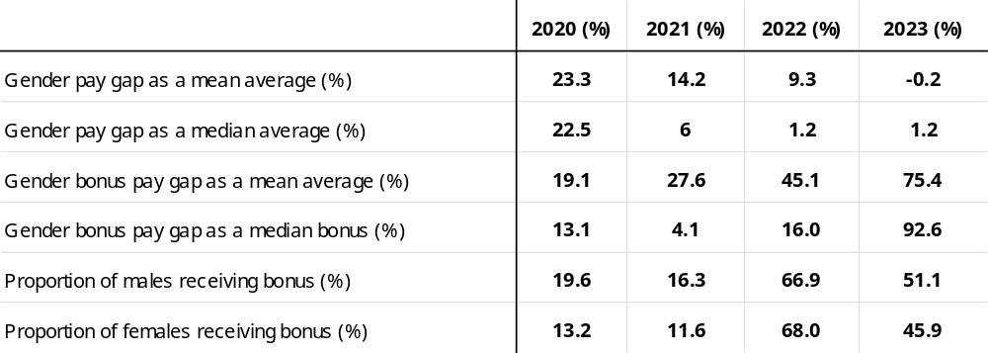
OUR RESULTS
Our Results
Coffee#1 - Gender Pay Report 2023

Slide 4


OUR RESULTS
Gender pay gap as a mean average
The difference in pay between our total wage spend-per-woman and our total wage spend-per man.
Gender pay gap as a median average
The difference in pay between the middle-ranking woman and the middle-ranking man.
-0.2%
1.2%
MEAN BONUS PAY GAP
Gender bonus pay gap as a mean average
The difference in bonus between our total bonus paid-per-woman and total bonus paid-per-man
Gender bonus pay gap as a median average
The difference in bonus pay between the middle-ranking woman and the middle-ranking man.
75.4%
92.6%
Coffee#1 - Gender Pay Report 2023

Slide 5
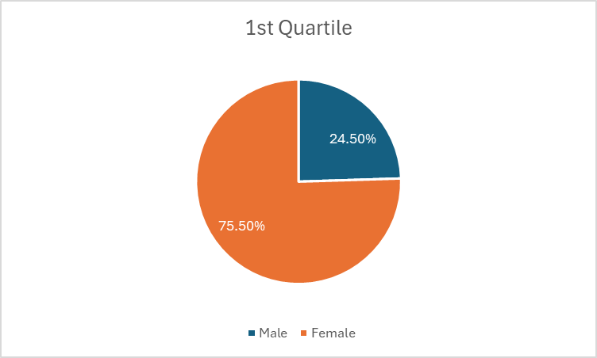
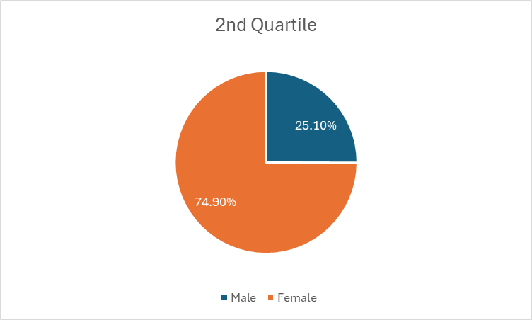
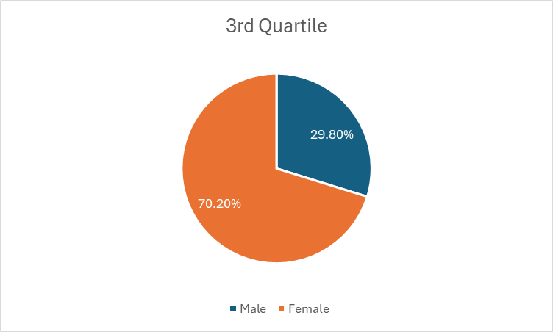
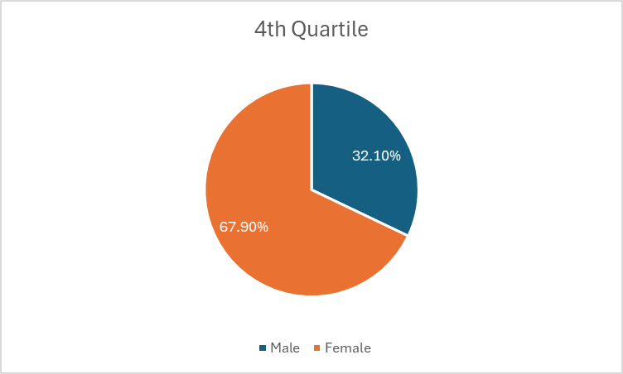
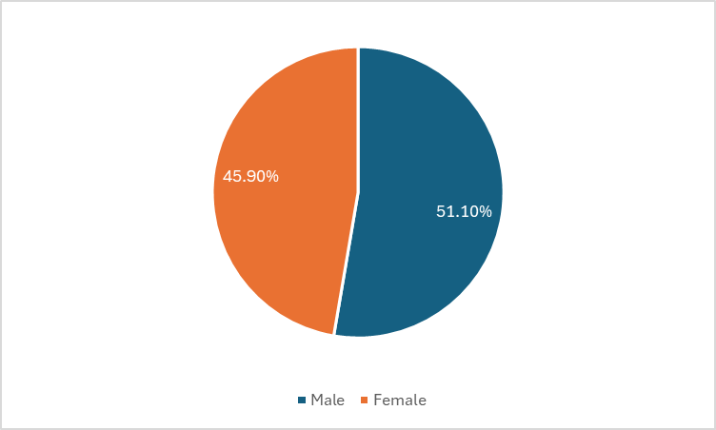
OUR RESULTS
Proportion of Males and Females by Pay Quartile
Proportion of Males and Females receiving bonus
Coffee#1 - Gender Pay Report 2023

Slide 6
GENDER PAY GAP 2020
Coffee#
Coffee#1 is is an inclusive and merit-led business; welcoming of the diverse perspectives that different nationalities, sexualities, cultures and genders provide. We are committed to inequality of reward regardless of gender, sexuality or ethnicity and are proud of the significant improvements that have been made to mean and median pay rates.
We believe whole-heartedly in rewarding our teams fairly and supporting all employees with their desired development, to enable both career and compensation progression.
OUR PLAN:
While we recruit some of our employees externally, our people strategy is built clearly upon developing from within. We are proud of our employer brand and delighted that over 75% of our employees recommend Coffee#1 as a place to work. The opportunity to acquire skill and grow both as a person and a professional are important to our teams and our action plan for the next year is designed to provide a framework of development and reward that is fair and progressive.
Our actions include:
  Continued review of our packages of compensation and benefits extending to pay rate, salary, bonus and benefits
  The introduction of a series of development programs that afford employees at all levels of Coffee#1 the opportunity to acquire new skills and progress
  The addition of new workplace training and workshops that enable our teams to work cohesively and respect the diversity of the team we employ
  The continuation of fully merit-based recruitment and reward processes

