Slide 1
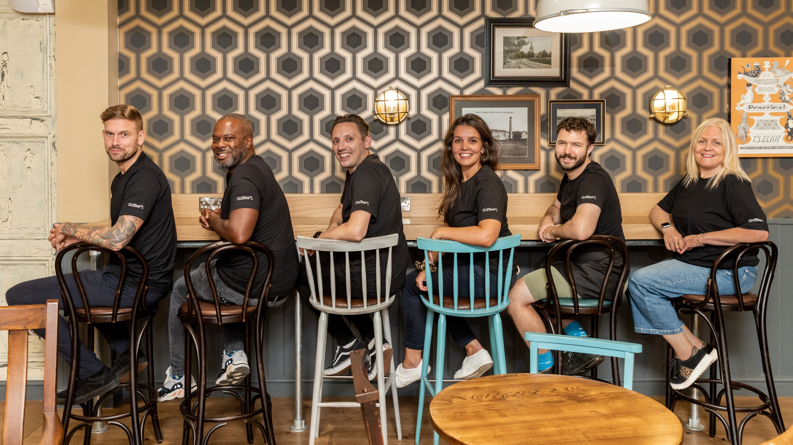
GENDER PAY REPORT 2022

Slide 2

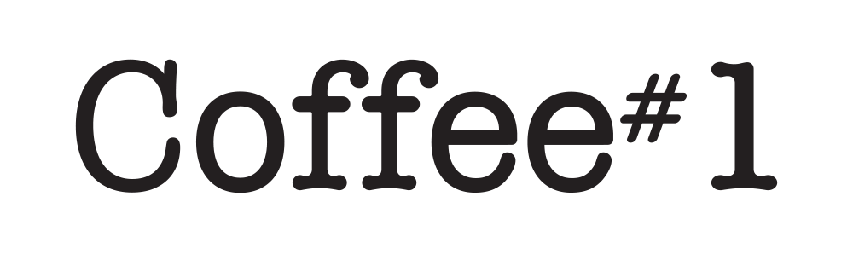
GENDER PAY GAP 2020
Coffee#1 is and will remain an inclusive business that is welcoming of the diverse perspectives that different nationalities, sexualities, cultures and genders provide.
We are required to report on gender pay rates based on a snapshot of data taken from 5th April 2022 using all relevant employees.
Our gender pay gap is starting to return to pre covid results. There is an increase in the mean and median bonus pay, from last year. The mean gender pay gap has reduced from 14% to 9.3% and median from 6% to 1.23%, a positive result we intend to build on.
We recognise that there is remaining work for us to do to address gender inequality in our business. We are committed to addressing this and have identified some initial actions that are outlined at the end of this report.
I am confident that the data and information reported are accurate as of the snapshot date of 5 April 2022 and have been calculated according to the requirements of The Equality Act 2010 (Gender Pay Information) Regulations 2017.
Bruce Newman
Manging Director
Coffee#1

Slide 3

OUR RESULTS
Our Results
 | 2020 (%) | 2021 (%) | 2022 (%)
Gender pay gap as a mean average (%) | 23.3 | 14.2 | 9.32
Gender pay gap as a median average (%) | 22.5 | 6.0 | 1.23
Gender bonus pay gap as a mean average (%) | 19.1 | 27.6 | 45.13
Gender bonus pay gap as a median bonus (%) | 13.1 | 4.1 | 16.01
Proportion of males receiving bonus (%) | 19.6 | 16.3 | 66.93
Proportion of females receiving bonus (%) | 13.2 | 11.6 | 67.98
Coffee#1 - Gender Pay Report 2022

Slide 4

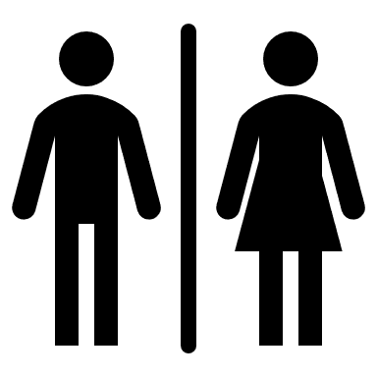
OUR RESULTS
Gender pay gap as a mean average
The difference in pay between our total wage spend-per-woman and our total wage spend-per man.
Gender pay gap as a median average
The difference in pay between the middle-ranking woman and the middle-ranking man.
9.32%
1.23%
MEAN BONUS PAY GAP
Gender bonus pay gap as a mean average
The difference in bonus between our total bonus paid-per-woman and total bonus paid-per-man
Gender bonus pay gap as a median average
The difference in bonus pay between the middle-ranking woman and the middle-ranking man.
45.13%
16.01%
Coffee#1 - Gender Pay Report 2022

Slide 5
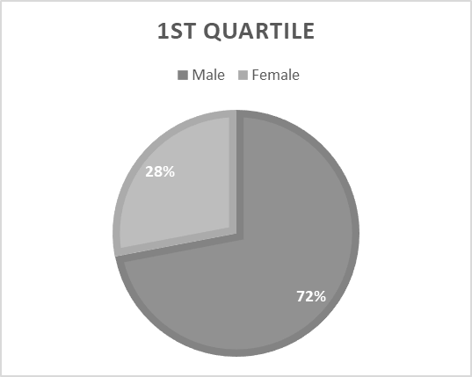
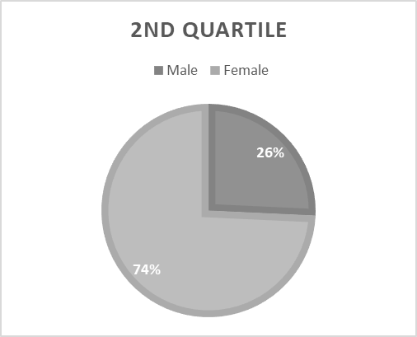
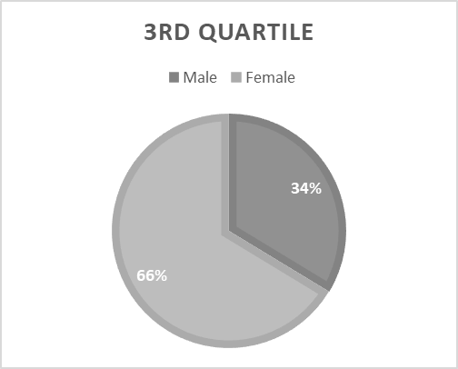
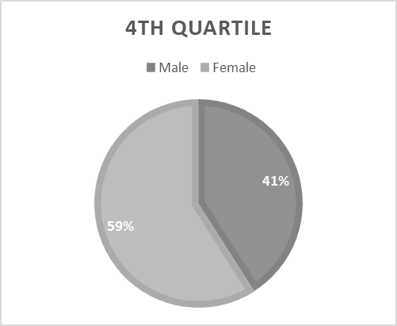
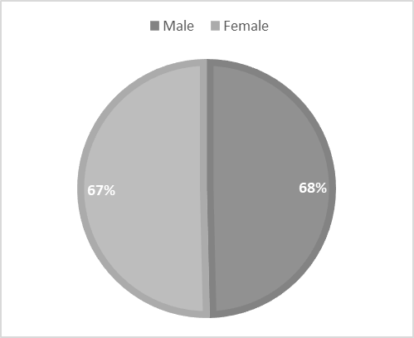
OUR RESULTS
Proportion of Males and Females by Pay Quartile
Proportion of Males and Females receiving bonus
Coffee#1 - Gender Pay Report 2022

Slide 6
GENDER PAY GAP 2020
Coffee#
Coffee#1 is is an inclusive and merit-led business; welcoming of the diverse perspectives that different nationalities, sexualities, cultures and genders provide. We are committed to inequality of reward regardless of gender, sexuality or ethnicity.
While our mean and median gender pay gap have reduced between the 2020 and 2021 snapshot dates, the opportunity for review and the implement of further action remains.
OUR PLAN:
Our people strategy is simple and based upon the principle of attracting and developing brilliant people with values that align with the Coffee#1 employer brand. This principle is complimented by a determination to provide a framework of fair and progressive reward.
Our 2023 actions will include:
  Continued review of our packages of compensation and benefits extending to pay rate, salary, bonus and benefits
  The continuation of our development programs including the addition of diversity in the workplace training to enable professional and personal growth
  The continuation of fully merit-based recruitment and reward processes

